Slide 1
Lecture No 01:
Prerequisite for MIS
ILO – BE – Management Information System(MIS)
Rina Bora
Assistant Professor
Dept. of Computer Engineering, SIES Graduate School of Technology
1

Slide 2
Information Technology
Information Technology (IT) refers to any computer-based tool that people use to work with information and to support the information and information-processing needs of an organization.
2

Slide 3
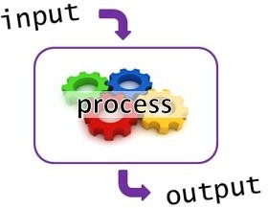
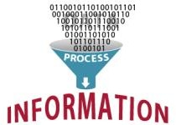
Introduction
https://www.101computing.net/wp/wp-content/uploads/input-process-output.png
People –(follow)> Procedures –(manipulate)> Data –> Information
3

Slide 4
Information System
An Information System (IS) collects, processes, stores, analyzes, and disseminates information for a specific purpose.
The purpose of information systems has been defined as getting the right information to the right people, at the right time, in the right amount, and in the right format.
Information systems are intended to supply useful information.
Information systems contain information about significant people, places, and things within the organization or in the environment surrounding it.
By information we mean data that have been shaped into a form that is meaningful and useful to human beings.
Data, in contrast, are streams of raw facts.
4

Slide 5
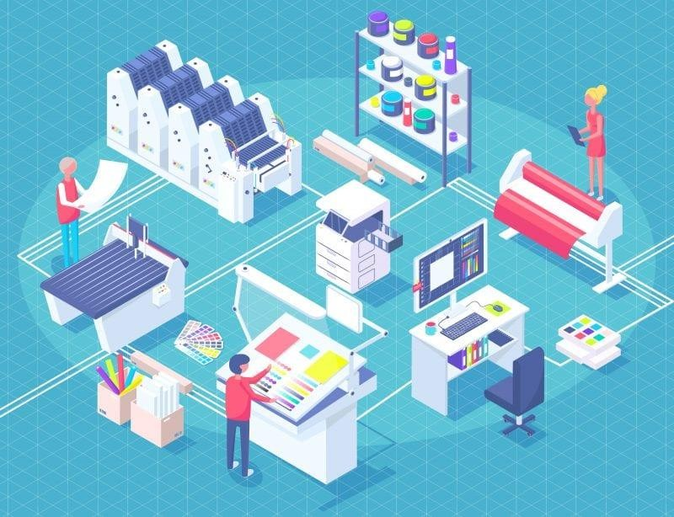
Information System
5

Slide 6
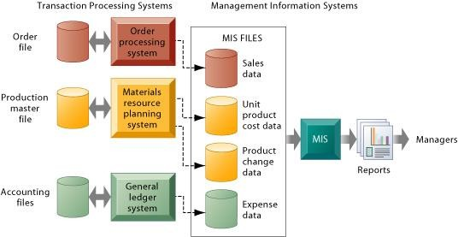
Information System
Fig: How management information systems obtain their data from the organization’s TPS
6
Notes:
In the system illustrated by this diagram, three TPS supply summarized transaction data to the MIS reporting system at the end of the time period. Managers gain access to the organizational data through the MIS, which provides them with the appropriate reports.

Slide 7
Why Should We Study Information Systems?
We practice continuous computing, surrounded by a movable Information network.
Network- digital devices, the wired and wireless networks
and Web-based tools for finding , communicating Information.
This network enables us to fetch information about virtually
anything from anywhere, at any time, and to send our own ideas back to the Web, from wherever you are, via a mobile device.
7

Slide 8
The Informed User— Us!
Informed user - a person knowledgeable about information systems and information technology. There are several reasons why you should be an informed user.
better understanding of those applications
enhance the quality of IT applications
recommend and help select more appropriate IT applications
improve organization’s performance, teamwork as well as
own productivity.
helps to become an entrepreneur
8

Slide 9
Introduction To Information Systems (IS): Computer Based Information Systems, Impact of IT on organizations, Importance of IS to Society. Organizational Strategy, Competitive advantages and IS
Module 1
9

Slide 10
Business Process
Business processes are the collection of activities required to produce a product or service.
These activities are supported by flows of material, information, and knowledge among the participants in business processes.
Business processes also refer to the unique ways in which organizations coordinate work, information, and knowledge, and the ways in which management chooses to coordinate work.
To a large extent, the performance of a business firm depends on how well its business processes are designed and coordinated.
10

Slide 11
Business Process
Every business can be seen as a collection of business processes, some of which are part of larger encompassing processes.
For instance, uses of mentoring, wikis, blogs, and videos are all part of the overall knowledge management process.
Many business processes are tied to a specific functional area.
For example, the sales and marketing function is responsible for identifying customers, and the human resources function is responsible for hiring employees.
11

Slide 12
Business Process
Table describes some typical business processes for each of the functional areas of business.
12

Slide 13
Business Function V/S Business Process
A business function is a specific area of work within an organization that is responsible for specific tasks.
A business process is a set of activities that an organization performs to achieve a specific business goal.
Business functions exist to ensure that specific tasks are completed within an organization.
Business Function
Customer Service department - replace / repair
Business Process
Repair/ Replace is a Business Process.
13

Slide 14
Business Process
Business process excellence is widely recognized as the underlying basis for all significant measures of competitive performance in the organization. Consider these measures, for example:
• Customer satisfaction: the result of optimizing and aligning business processes to fulfill the customer’s needs, wants, and desires.
• Cost reduction: the result from optimizing operations and supplier processes.
• Cycle and fulfillment time: the result of optimizing the manufacturing and logistics processes.
• Quality: the result of optimizing the design, development, and production processes.
• Differentiation: the result of optimizing the marketing and innovation processes.
• Productivity: the result of optimizing each individual’s work processes.
14

Slide 15
Business Process
Information technology was the key enabler of radical change.
This radical redesign, called business process reengineering (BPR), is an approach that improves the efficiency and effectiveness of an organization’s business processes.
The key to BPR is for enterprises to examine their business processes from a “clean sheet” perspective and then determine how they could best reconstruct those processes to improve their business functions.
15

Slide 16
Business Process
Customers look for Business functional areas
To provide satisfaction to customers, organisation must have all business functional areas to be integrated.
This leads to
shared information
increased efficiency
accurately & timely sharing of information
Integrated Information Systems
16

Slide 17
IT Offers Career Opportunities
The people who design and build IS.
The people who use those systems
The people responsible for managing those systems.
At the top of the list is the Chief Information Officer (CIO).
CIO works with the Chief Executive Officer (CEO), the Chief
Financial Officer (CFO), and other senior executives.
Software Developer, Computer System Analyst, Information Security Analyst, Web Developer, IT Manager, Software Architect, Video Game Designer, Database Developer, Information Assurance (Security) Analyst, Clinical Applications Specialist (IT in healthcare), User Experience Designer, IT Program Manager
17

Slide 18
Managing Information Resources
IS have enormous strategic value to organizations.
ISs are very expensive to acquire, operate, and maintain.
The evolution of the MIS function within the organization.
The responsibility for managing information resources is now divided between the MIS department and the end users.
Division of responsibility depends on several factors: the size and nature of the organization, the amount and type of IT resources, the organization’s attitudes toward computing, the attitudes of top management toward computing, the maturity level of the technology, the amount and nature of outsourced IT work, and even the countries in which the company operates.

Slide 19
Traditional Functions of the MIS Department
Managing systems development and systems project management
Managing computer operations, including the computer center
Staffing, training, and developing IS skills
Providing technical services
Infrastructure planning, development, and control

Slide 20
New Functions of the MIS Department
Initiating and designing specific strategic information systems
Incorporating the Internet and electronic commerce into the business
Managing system integration including the Internet, intranets, and extranets
Educating the non-MIS managers about IT
Educating the MIS staff about the business
Partnering with business-unit executives
Managing outsourcing
Proactively using business and technical knowledge to seed innovative ideas about IT
Creating business alliances with business partners

Slide 21
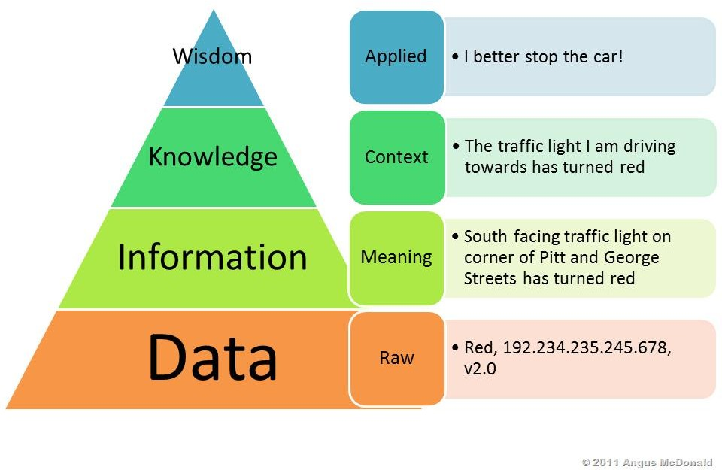
Computer-Based Information Systems
http://www.cvev.org/wp-content/uploads/2016/04/Difference-between-data-information-and-knowledge.jpg

Slide 22
Data Vs. Information
Data items refer to an elementary description of things, events, activities, and transactions that are recorded, classified, and stored but are not organized to convey any specific meaning.
Data items can be numbers, letters, figures, sounds, and images.
Examples of data items are collections of numbers (e.g., 3.11, 2.96, 3.95, 1.99, 2.08) and characters (e.g., B, A, C, A, B, D, F, C).
Information refers to data that have been organized so that they have meaning and value to the recipient. For example, a grade point average (GPA) by itself is data, but a student’s name coupled with his or her GPA is information.
The recipient interprets the meaning and draws conclusions and implications from the information.
22

Slide 23
Knowledge
Knowledge consists of data and/or information that have been organized and processed to convey understanding, experience, accumulated learning, and expertise as they apply to a current business problem.
For example, suppose that a company recruiting at your school has found over time that students with grade point averages over 3.0 have experienced the greatest success in its management program.
Based on this accumulated knowledge, that company may decide to interview only those students with GPAs over 3.0.
This example presents an example of knowledge because the company utilizes information—GPAs—to address a business problem—hiring successful employees.
23

Slide 24
Data, Information, Knowledge, Wisdom
Data items - an elementary description of things, events, activities, and transactions that are recorded, classified, and stored but are not organized to convey any specific meaning. Data items can be numbers, letters, figures, sounds, and images.
Information - data that have been organized so that they have meaning and value to the recipient.
92%
92% - Disha

Slide 25


Data, Information, Knowledge, Wisdom
Knowledge - consists of data and/or information that have been organized and processed to convey understanding, experience, accumulated learning, and expertise as they apply to a current business problem.
92% - Disha
92% - Disha , eligible for placements of with direct interview session
Wisdom - the process by which we also discern, or judge, between right and wrong, good and bad.
decided to hire Disha after her interview.

Slide 26
Computer-based information system (CBIS)
An information system that uses computer technology to perform some or all of its intended tasks.
Hardware- consists of devices such as the processor, monitor, keyboard,
and printer.
Software - is a program or collection of programs that enable the hardware to process data.
A database is a collection of related files or tables containing data.
A network is a connecting system (wireline or wireless) that permits different computers to share resources.
Procedures- are the instructions for combining the above components to process information and generate the desired output.
People use the hardware and software, interface with it, or utilize its output.

Slide 27
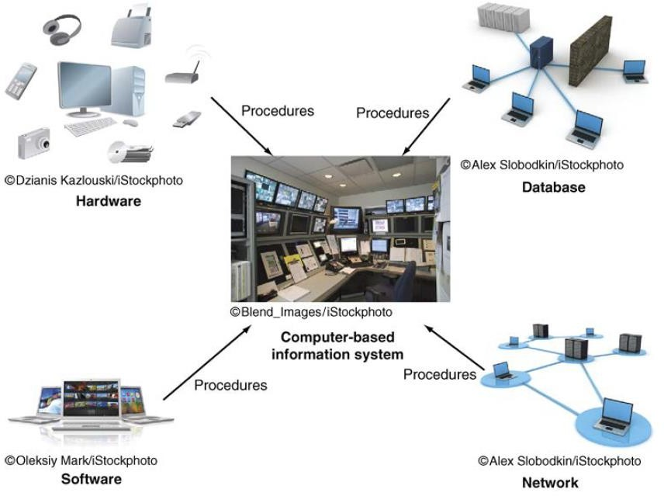
Computer-based information system (CBIS)
http://docshare01.docshare.tips/files/31709/317098453.pdf

Slide 28
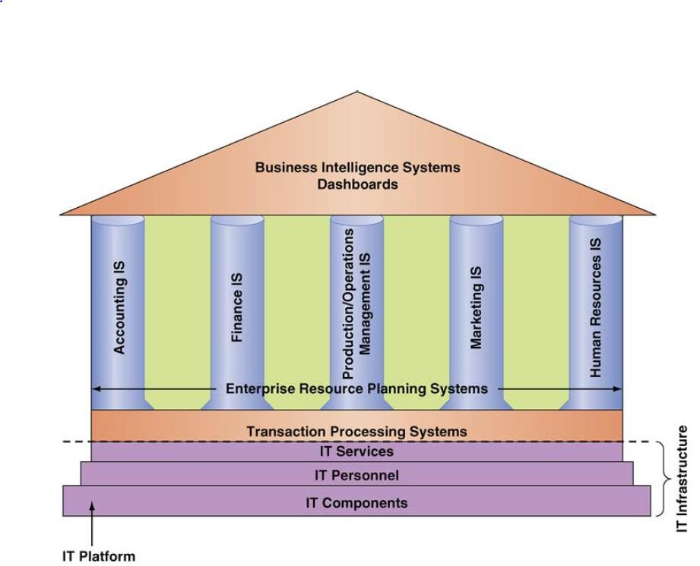
IT inside your organization
http://docshare01.docshare.tips/files/31709/317098453.pdf

Slide 29
IT inside your organization
IT Platform- IT components of hardware, software, networks (wireline and wireless), and databases.
IT Personnel- use these components to develop information systems, oversee security and risk, and manage data.
IT services- These activities cumulatively are called information technology services
IT Infrastructure- Comprises the organization’s IT component plus IT services
An application (or app)- is a computer program designed to support a specific task or business process.
Departmental Information System (Functional Area IS)- The collection of application programs in a single. They are the supporting pillars for the IS.
Eg.- Sales & Marketing, Human Resource Information System(HRIS)

Slide 30
IT inside your organization
In sales and marketing, managers following functions:
use IT to perform the
Product analysis: Developing new goods and services.
Site analysis: Determining the best location for production and distribution facilities.
Promotion analysis: Identifying the best advertising channels.
Price analysis: Setting product prices to obtain the highest total revenues.

Slide 31
IT inside your organization
Managers in Human Resources use IT to manage
the recruiting process, analyze and screen job applicants, and
hire new employees.
help employees manage their careers, to administer performance tests to employees, and to monitor employee productivity.
Finally they rely on IT to manage compensation and benefits packages.

Slide 32
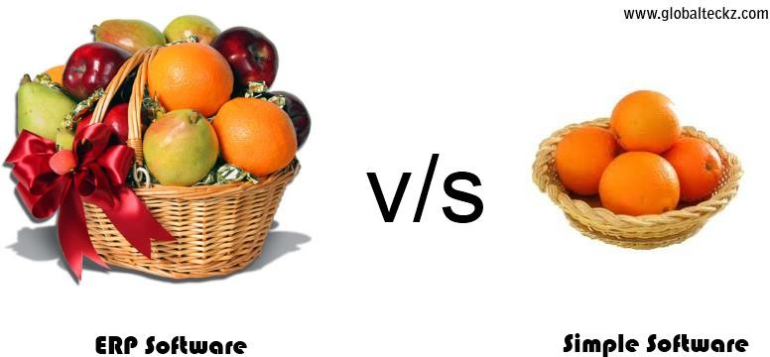
IT inside your organization
Enterprise Resource Planning (ERP)
ERP V/S Software
http://blogs.globalteckz.com/wp-content/uploads/2013/07/erp-and-simple-software.png

Slide 33
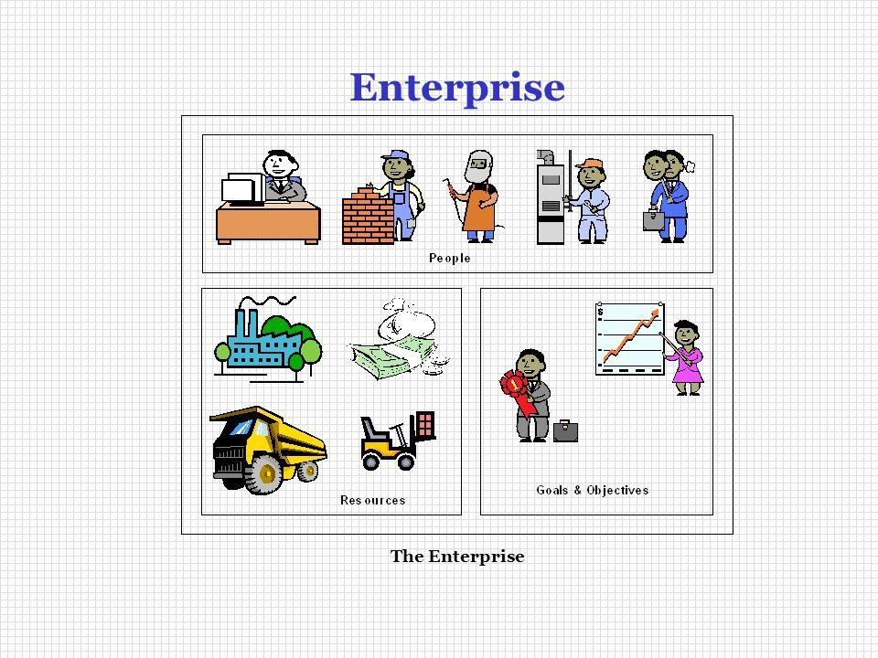
IT inside your organization
Enterprise Resource Planning (ERP):
Group of people
Common goal
Have certain resources
“ERP Demystified”, Alexis Leon, Second edition TMH

Slide 34
IT inside your organization
Enterprise Resource Planning (ERP):
ERP is a set of integrated business applications, or modules which carry out common business functions such as general ledger, accounting, or order management

Slide 35
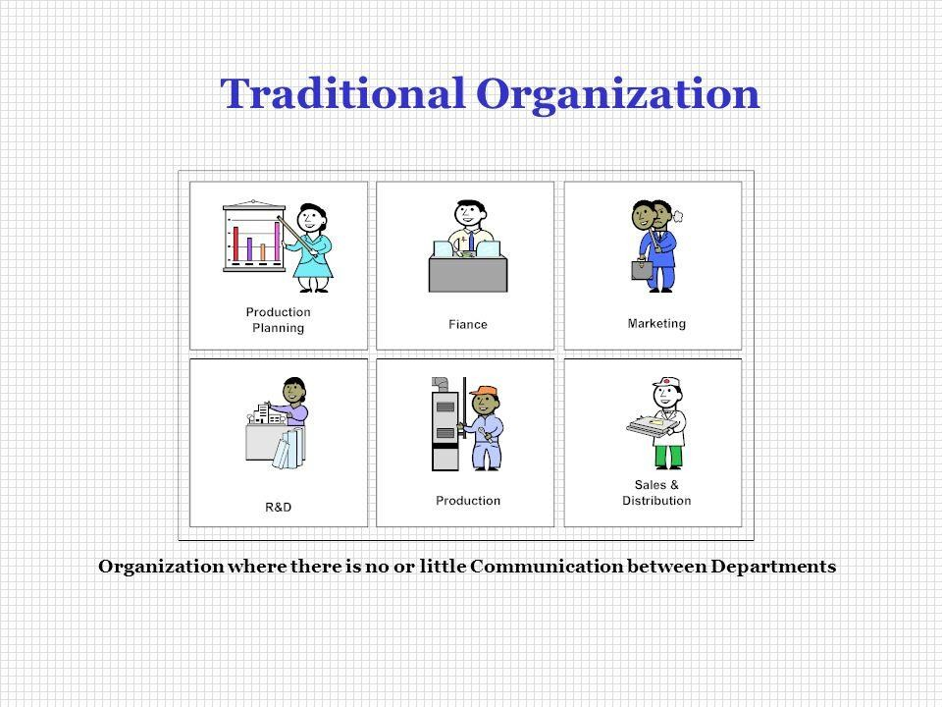
IT inside your organization
“ERP Demystified”, Alexis Leon, Second edition TMH

Slide 36
IT inside your organization
Problems with function based application:
Sharing of data between systems
Data duplication
Data inconsistency
Applications that don’t talk to one another
Limited or lack of integrated information
Isolated decisions lead to overall inefficiencies
Increased expenses

Slide 37
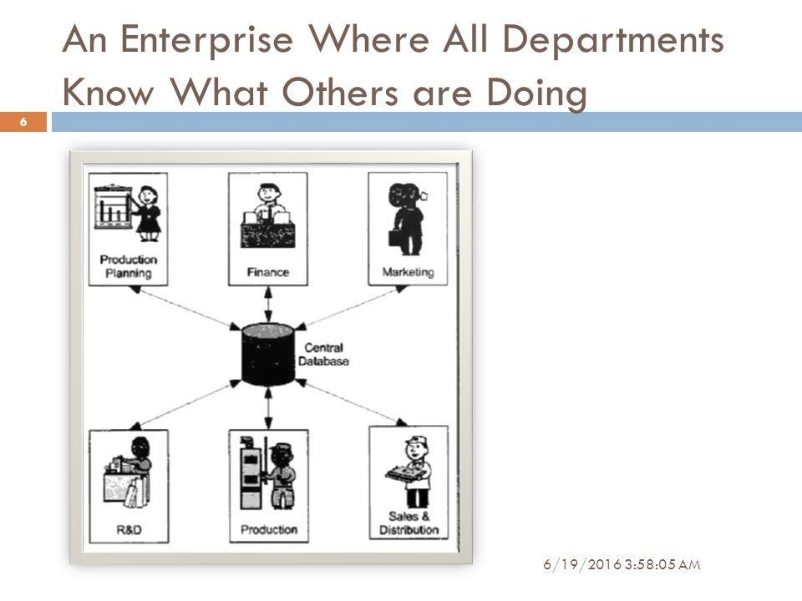
IT inside your organization
Enterprise Resource Planning (ERP):
“ERP Demystified”, Alexis Leon, Second edition TMH

Slide 38
IT inside your organization
Benefits of ERP:
Reduction in Cycle time
Improved resource utilization
Better customer satisfaction
Improved supplier performance
Increased flexibility
Reduced quality costs
Better analysis & planning capabilities
Improved information accuracy & decision-making capability
Use of latest technology

Slide 39
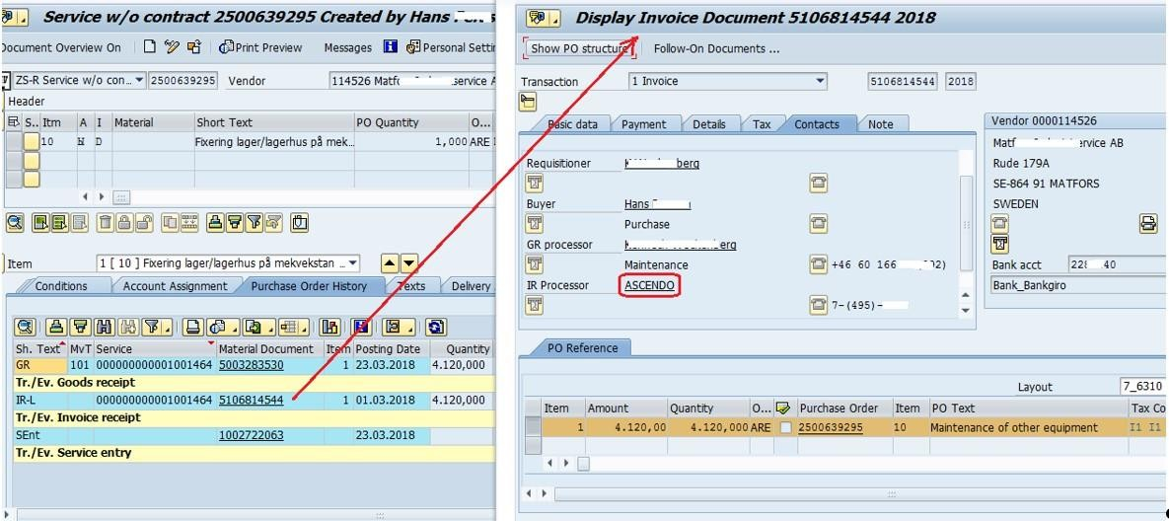
IT inside your organization
Enterprise Resource Planning (ERP):
https://blogs.sap.com/wp-content/uploads/2018/07/Figure-8-An-example-of-
the-invoice-created-in-SAP-ER P-based-from-Ascendo-data.jpg

Slide 40
Types of Computer-Based Information Systems
Two information systems that support the entire organization
Enterprise Resource Planning systems(ERPs)
Transaction Processing Systems(TPS)
ERP & TPS, function primarily within a single organization

Slide 41
Types of Computer-Based Information Systems
Transaction Processing System (TPS)
TPS supports the monitoring, collection, storage, and processing of data from the organization’s basic business transactions, each of which generates data.
The IS definition of a transaction is broader: A transaction is anything that changes the firm’s database.
Collects data in real time and it provides the input data for the corporate databases.
TPSs are considered critical as they support core operations.
Significantly, nearly all ERP systems are also TPSs, but not all TPSs
are ERP systems.

Slide 42
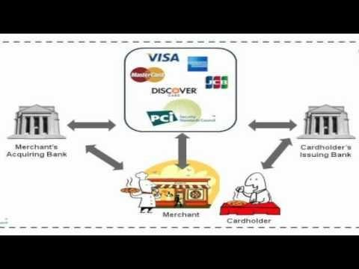
IT inside your organization
Transaction Processing System(TPS):
https://www.google.com/url?sa=i&rct=j&q=&esrc=s&source=imgres&cd=&cad=rja&uact=8&ved=2ahUKEwj03ce
CgIbrAhXkzjgGHXxsAEMQjRx6BAgBEAQ&url=https%3A%2F%2Fsites.google.com%2Fsite%2Fmrjoneswac%
2Fyr12-information-processes-and-technology%2Ftopic-5-transaction-processing-systems%2Flesson1-
whatisatransactionprocessingsystem&psig=AOvVaw2-DT3r3uxyaVgPUPTo8ynX&ust=1596783445581226
Leena Ladge

Slide 43
Types of Computer-Based Information Systems
Major Capabilities of Information Systems
Perform high-speed, high-volume numerical computations.
Provide fast, accurate communication and collaboration within and among organizations.
Store huge amounts of information in an easy-to-access, yet small space.
Allow quick and inexpensive access to vast amounts of information, worldwide.
Analyze and interpret vast amounts of data quickly and efficiently.
Automate both semiautomatic business processes and manual tasks.

Slide 44
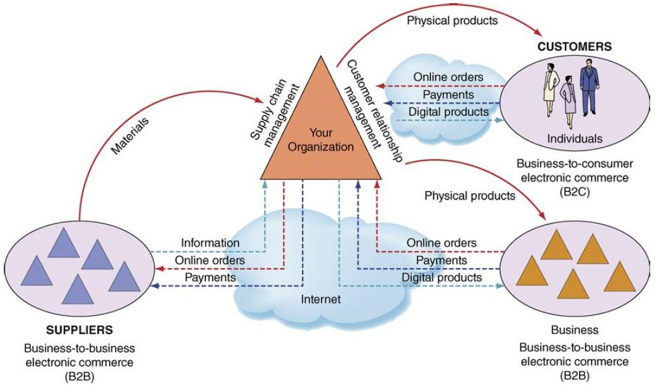
ISs that function among multiple organizations
http://docshare01.docshare.tips/files/31709/317098453.pdf

Slide 45
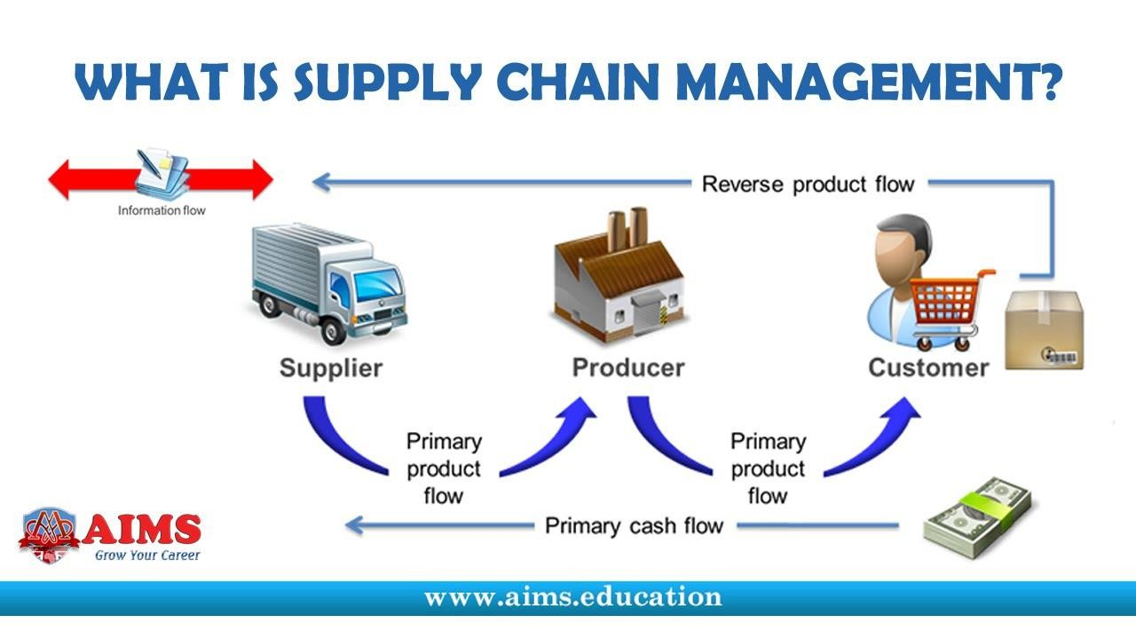
Types of Computer-Based Information Systems
Interorganizational Information Systems (IOSs).
Connect two or more organizations
Support many interorganizational operations –Eg. Supply Chain Management
An organization’s supply chain is the flow of materials, information, money, and services from suppliers of raw materials through factories and warehouses to the end customers.

Slide 46
Types of Computer-Based Information Systems
Interorganizational Information Systems (IOSs).
Electronic commerce (e-commerce) systems
The process of buying, selling, transferring products or services and or information via computer networks including internet.
It is the subset of e-Business.
Some examples -online banking, online shopping, online ticket booking, social networking, etc.
The basic requirement of e-commerce is a website.

Slide 47
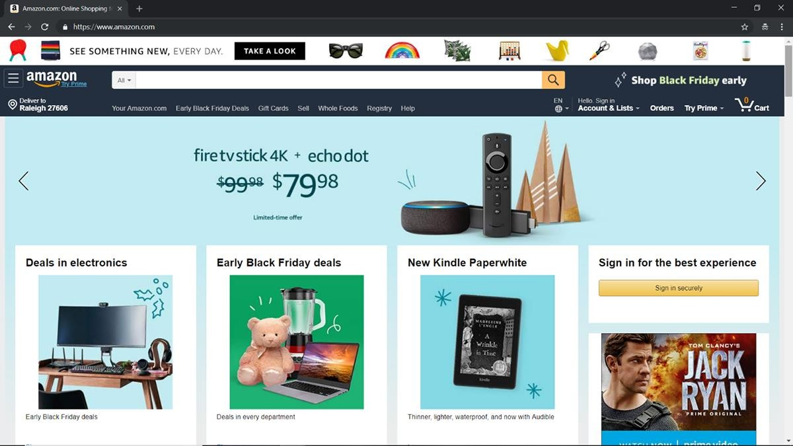
Types of Computer-Based Information Systems
Interorganizational Information Systems (IOSs).
Electronic commerce (e-commerce) systems

Slide 48
Types of Computer-Based Information Systems
Support for Organizational Employees
Information Systems that typically support particular employees
within the organization.
Clerical workers, who support managers at all levels of the organization, include bookkeepers, secretaries, electronic file clerks, and insurance claim processors.
Lower-level managers handle the day-to-day operations of the organization, making routine decisions such as assigning tasks to employees and placing purchase orders.
Middle managers make tactical decisions, which deal with activities
such as short-term planning, organizing, and control.

Slide 49
Types of Computer-Based Information Systems
Support for Organizational Employees
Knowledge workers are professional employees such as financial and marketing analysts, engineers, lawyers, and accountants. (Act as advisors to middle managers and executives)
Finally, executives make decisions that deal with situations that can significantly change the manner in which business is done. (introducing a new product line, acquiring other businesses, and relocating operations to a foreign country )

Slide 50
Types of Computer-Based Information Systems
Support for Organizational Employees
Office automation systems (OASs) typically support the clerical staff, lower and middle managers, and knowledge workers. These employees use OASs to develop documents (word processing and desktop publishing software), schedule resources (electronic calendars), and communicate (e-mail, voice mail, videoconferencing, and groupware).
Business intelligence (BI) systems provide computer-based support for complex, non-routine decisions, primarily for middle managers and knowledge workers. These systems are typically used with a data warehouse, and they enable users to perform their own data analysis.

Slide 51
Types of Computer-Based Information Systems
Support for Organizational Employee
Expert systems (ES) attempt to duplicate the work of human experts by applying reasoning capabilities, knowledge, and expertise within a specific domain. They have become valuable in many application areas, primarily but not exclusively areas involving decision making. For example, navigation systems use rules to select routes, but we do not typically think of these systems as expert systems.
Dashboards (also called digital dashboards) are a special form of IS that support all managers of the organization. They provide rapid access to timely information and direct access to structured information in the form of reports. Dashboards that are tailored to the information needs of executives are called executive dashboards.

Slide 52
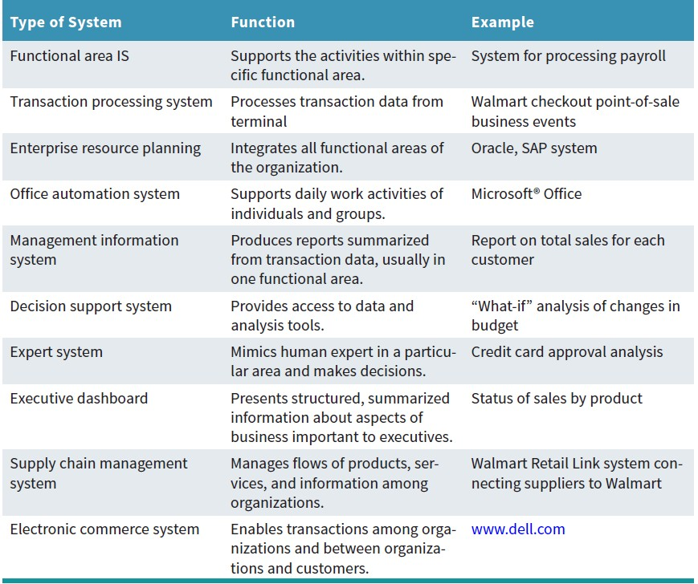
Types of Organizational Information Systems

Slide 53
How Does IT Impact Organizations?
For majority of organizations, if their ISs fail, they cease operations until the problems are found and fixed.
Consider these examples:
In July 2015, United Airlines flights were grounded.
Also in July 2015, the New York Stock Exchange suspended trading for almost four hours due to a software upgrade.

Slide 54
IT Impacts Entire Industries
Software is impacting every industry, and every organization must prepare for these impacts.
Let’s examine a few examples of software disruption across several industries. Many of these examples focus on two scenarios:
Industries where software disrupted the previous market- leading companies
Industries where a new company (or companies) used software to achieve a competitive advantage.

Slide 55
IT Impacts Entire Industries
The Book Industry
Largest book publisher and bookseller in the United States?
Amazon
Its software engine, which can sell virtually anything online without building
or maintaining any retail stores. (electronic (or digital) books, or eBooks.)
Borders bookstore chain.
In 2001, Borders agreed to hand over its online business to Amazon because Borders was convinced that online book sales were nonstrategic and unimportant. Ten years later, Borders filed for bankruptcy.

Slide 56
IT Impacts Entire Industries
The Music Industry
Total U.S. album sales peaked in 2000, after Napster was created. (Napster allowed anyone to download and trade music for free.)
From 2000 to 2015, the major music labels (companies) worked diligently to eliminate illegal downloading and sharing, but album sales continued to decline. This resulted in around $8 billion less in annual retail sales in 2015 than they did in 2000.
the “Big Three” music labels: Warner Music Group (www.wmg.com), Universal Music (www.universalmusic.com) and
Sony (www.sonymusic.com).
60

Slide 57
IT Impacts Entire Industries
The Music Industry
Digital music streaming technologies over the Internet.
Two digital-streaming business models emerged:
Internet radio companies such as Pandora (www.pandora.com) that allow subscribers to passively listen to music that is customized for their tastes
Interactive companies such as Spotify (www.spotify.com) and Apple’s iTunes (www.apple.com/itunes) that allow users to pick songs.

Slide 58
IT Impacts Entire Industries
The Video Industry
Blockbuster
which rented and sold videos and ancillary products through its chain of stores
was the industry leader until it was disrupted by a soft ware company,
Netflix (www.netflix.com).
In mid-2015, Netflix had the largest subscriber base of any video service with millions of subscribers. Meanwhile,
Blockbuster declared bankruptcy in February 2011 and was acquired by satellite television provider Dish Network (www.dish.com).

Slide 59
IT Impacts Entire Industries
The Software Industry
Companies such as Oracle and Microsoft are increasingly threatened by software-as-a-service (SaaS) products (e.g., Salesforce.com) and Android, an open-source operating system developed by the Open Handset Alliance (www.openhandsetalliance.com).

Slide 60
IT Impacts Entire Industries
The Videogame Industry
Today, the fastest growing entertainment companies are video-game makers
Zynga (www.zynga.com),
the creator of Farm-Ville; Rovio (www.rovio.com), the maker of Angry Birds; and Minecraft (www.minecraft .net), now owned by Microsoft (www.microsoft
.com).

Slide 61
IT Impacts Entire Industries
The Marketing Industry
Largest direct marketing companies include Facebook (www.facebook.com),
Google (www.google.com), and Foursquare (www.foursquare.com).
All of these companies are using software to disrupt the retail marketing industry.

Slide 62
IT Impacts Entire Industries
The Photography Industry
This industry was disrupted by software years ago. Today it is virtually impossible to buy a mobile phone that does not include a software- powered
camera.
In addition, people can upload photos automatically to the Internet for permanent archiving and global sharing.
Leading photography companies include Shutterfly (www.shutterfly.com), Snapfish (www.snapfish.com), Flickr (www.flickr.com), and Instagram (www.instagram.com).
Meanwhile, the longtime market leader, Kodak—whose name was almost
synonymous with cameras—declared bankruptcy in January 2012.

Slide 63
IT Impacts Entire Industries
The Recruiting Industry
LinkedIn (www.linkedin.com) is disrupting the traditional job recruiting
industry.
For the first time, employees and job searchers can maintain their resumes on a publicly accessible Web site so that interested parties can search in real time.

Slide 64
IT Impacts Entire Industries
The Financial Services Industry
Practically every financial transaction (for example, buying and selling stocks)
is now performed by software.
Also, many of the leading innovators in financial services are software companies.
Square (https://squareup.com) allows anyone to accept credit card payments with a mobile phone.

Slide 65
IT Impacts Entire Industries
The Motion Picture Industry
Studios require state-of-the-art information technologies, including massive numbers of servers, sophisticated software, and an enormous amount of storage
DreamWorks Animation (www.dreamworksanimation.com), a motion picture studio that creates animated feature films, television programs, and online virtual worlds.
For a single motion picture, the studio manages more than 500,000 files and 300 terabytes of data, and it uses about 80 million CPU hours.

Slide 66
IT Impacts Entire Industries
The Automobile Industry
In modern cars, software runs the engines; controlling safety features; entertaining passengers; guiding drivers to their destinations; and connecting the car to mobile, satellite, and GPS networks, Wi-Fi receivers, maximize fuel efficiency, ultrasonic sensors.
The next step is to network all vehicles together : self-driving or driverless cars.
The creation of software-powered driverless cars is already being undertaken at Google as well as at several major car companies, and Apple.

Slide 67
IT Impacts Entire Industries
The Agriculture Industry
- Agriculture is increasingly powered by software, satellite analysis of soils
automated, driverless tractors controlled by GPS. (Precision agriculture is
based on variability.
- Mahindra
observing, measuring, and responding to inter- and intra-field
Driverless Tractor set to make farming more profitable &
productive, reduce health risk for farmers and change the future of food production

Slide 68
IT Impacts Entire Industries
The Fashion Industry
People keep buying clothes and then returning them after trial due to few
reasons.
Rent the Runway (www.renttherunway.com)
Made expensive clothing available on rent.
Disrupting traditional physical retailers.

Slide 69
IT Impacts Entire Industries
Education
UniversityNow (www.unow.com)
Founded to make college more accessible to working adults by offering online, self-paced degrees.
Two key characteristics distinguish UniversityNow from others
very low fees
fully accredited degrees, from an associate’s degree to an M.B.A.

Slide 70
IT Impacts Entire Industries
The Legal Profession
e-discovery software applications can analyze documents in a fraction of the
time that human lawyers would take, at a fraction of the cost.
For example, Blackstone Discovery (www.blackstonediscovery.com) helped one company analyze 1.5 million documents for less than $100,000.
It was estimated that the process would have cost $1.5 million had it been performed by lawyers.

Slide 71
IT reduces number of Middle Managers
IT makes managers more productive
IT increases the number of employees who can report to a single manager.
Thus, IT decreases the number of managers and experts.
If this trend materializes, promotional opportunities will decrease, making promotions much more competitive.

Slide 72
IT Changes the Manager’s Job
IT helps managers in making decisions.
IT often provides managers with near-real-time information.
IT also provides many tools—for example, business analytics applications such as dashboards, search engines, and intranets— to help managers handle the volumes of information.
Due to advances in IT, its easier to supervise employees and teams who are geographically dispersed

Slide 73
Will IT Eliminate Jobs?
One major concern of every employee, part-time or full-time, is job security.
Organizations are responding to today’s highly competitive
environment by doing more with less.
Regardless of your position, then, you consistently will have to
add value to your organization and to make certain that your superiors are aware of this value.

Slide 74
Will IT Eliminate Jobs?
Many companies have responded to difficult economic times, increased global competition, demands for customization, and increased consumer sophistication by increasing their investments in IT.
In fact, as computers continue to advance in terms of intelligence and capabilities, the competitive advantage of replacing people with machines is increasing rapidly.
This process frequently leads to layoffs. At the same time, however, IT creates entirely new categories of jobs, such as electronic medical record keeping and nanotechnology.

Slide 75
IT Impacts Employees at Work
Many people have experienced a loss of identity because of computerization.
The Internet threatens to exert an even more isolating influence than have computers and television.

Slide 76
IT Impacts Employees’ Health and Safety
Although computers and ISs are generally regarded as agents of “progress,” they can adversely affect individuals’ health and safety.
Consider two issues associated with IT: Job Stress and long-term use of the keyboard.

Slide 77
IT Impacts Employees’ Health and Safety
Job Stress
An increase in an employee’s workload and/or responsibilities can trigger job stress.
Computerization has also created an ever-expanding workload for some employees.
Some workers feel overwhelmed and become anxious about their job performance. These feelings of stress and anxiety can actually reduce workers’ productivity while risking their physical and mental health.
Management can help improve these problems by providing training, redistributing the workload among workers, and hiring more workers.

Slide 78
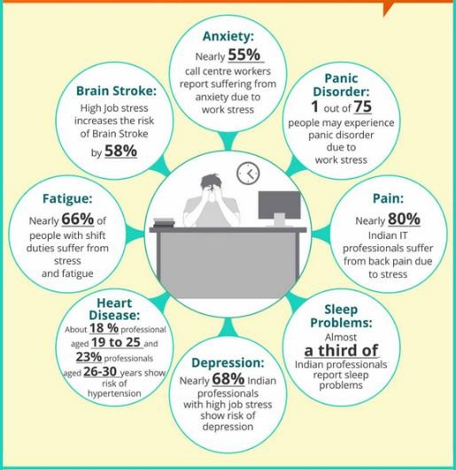
IT Impacts Employees’ Health and Safety
Job Stress
https://www.atlantictraining.com/blog/wp-content/uploads/2016/06/WORK-STRESS1.jpg

Slide 79
IT Impacts Employees’ Health and Safety
The long-term use of keyboards
An increase in an employee’s workload and/or responsibilities can trigger job stress.
can lead to repetitive strain injuries such as backaches and muscle tension in the wrists and fingers.
Carpal tunnel syndrome is a particularly painful form of repetitive strain injury
that affects the wrists and hands.
The science of designing machines and work settings that minimize injury and illness is called Ergonomics.
Examples- antiglare screens , chairs

Slide 80
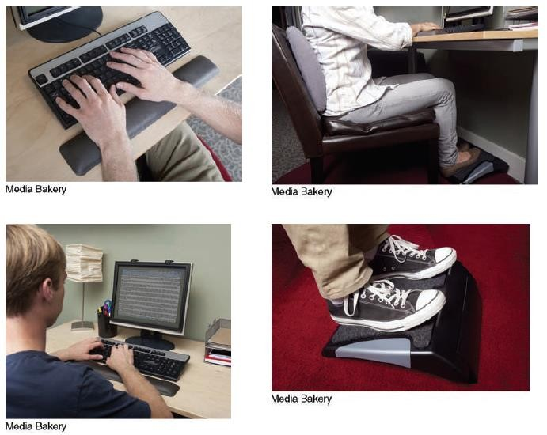
IT Impacts Employees’ Health and Safety
http://docshare01.docshare.tips/files/31709/317098453.pdf

Slide 81
IT Provides Opportunities for People with Disabilities
Integrating speech-recognition and vision-recognition capabilities.
For example, individuals who cannot type can use a voice-operated keyboard, and individuals who cannot travel can work at home.
People with impaired vision - manufacturers have added audible screen tips and voice interfaces
Improve the quality of life for people with disabilities.- two-way writing telephone, a robotic page turner, a hospital-bedside video trip to the zoo or the museum

Slide 82
Importance of Information Systems to Society
IT Affects Our Quality of Life
The workplace can be expanded to 24 hours a day at any location.
IT can provide employees with flexibility that can significantly improve the
quality of leisure time.
From the opposite perspective,
IT also can place employees on “constant call”(including vacations)
The majority of respondents take their laptops and smartphones on their vacations, and 100 percent took their cell phones.
The majority of respondents did some work while vacationing, and almost all of them checked their e-mail regularly.

Slide 83
Importance of Information Systems to Society
Improvements in Healthcare
IT has brought about major improvements in healthcare delivery.
Better and faster diagnoses, and accurate monitoring of critically ill patients
Streamlined process of researching and developing new drugs.
Expert systems help doctors diagnose diseases, and machine vision is enhancing the work of radiologists.
Surgeons use virtual reality to plan complex surgeries.
Surgical robots to perform long-distance surgery.
Doctors discuss complex medical cases via videoconferencing.
New computer simulations recreate the sense of touch, allowing doctors-in- training to perform virtual procedures without risking harm to an actual patient.

Slide 84
Importance of Information Systems to Society
The Robot Revolution Is Here Now
Autonomous devices have become increasingly common on factory floors, in hospital corridors, and in farm fields.
Drones A drone is an unmanned aerial vehicle (UAV) that either is controlled by pilots from the ground or autonomously follows a preprogrammed mission.
- Precision agriculture, Construction sites, Energy Industry, mining companies, film & television studios, mining companies etc.
Robots are extremely helpful in various environments, particularly those that are repetitive, harsh, or dangerous to humans.

Slide 85
IT for Restaurant Industry
- Consider the restaurant industry. You have probably visited some “old school” restaurants where your order is written down on a piece of paper and never entered into a computer system for preparation. You have most likely also been to a very modern
restaurant where you enter your own
smartphone, or other piece of equipment.
order with a tablet,

Slide 86
IT for Restaurant Industry(continued..)
Imagine that you are a manager in each type of restaurant. How does working without technology impact how you do your job? How does adding the technology change your performance?
Explain how restaurants could benefit from IT. Prepare a paragraph or two that will discuss the ways that the traditional job of a restaurant manager and other employees has been changed by IT.

Slide 87
Business Pressures, Organizational Responses, and Information Technology Support
Introduction
Organizations operate in the incredible complexity of the modern high-tech world. They are subjected to a numerous of business pressures.
IS are critically important in helping organizations respond to business pressures and in supporting organizations’ global strategies.
IS can be strategic, meaning that it can provide a competitive advantage if it is used properly.
IT can provide competitive advantage to organizations.
Competitive advantage refers to any assets that provide an organization with an edge against its competitors in some measure such as cost, quality, or speed.
To remain competitive, they must react rapidly to problems and opportunities that arise from extremely dynamic conditions

Slide 88
Business Pressures
The business environment is the combination of social, legal, economic, physical, and political factors in which businesses conduct their operations.
Significant changes in any of these factors are likely to create business pressures on organizations.
Organizations typically respond to these pressures with activities supported by IT.

Slide 89
Business Pressures
A - Market Pressures.
1. Globalization
The integration and interdependence of economic, social, cultural, and ecological facets of life, made possible by rapid advances in IT.
Connect, compute, communicate, collaborate, and compete everywhere and anywhere, anytime and all the time; to access limitless amounts of information, services, and entertainment; to exchange knowledge; and to produce and sell goods and services.
Operate without regard to geography, time, distance or even language barriers.
For ex- MNCs
Many automobile manufacturers use parts from other countries, such as a car being assembled in the United States with parts coming from Japan, Germany, or Korea.

Slide 90
Business Pressures
A - Market Pressures.
2. The Changing Nature of the Workforce.
The workforce, in developed countries, is becoming more diversified.
Increasing numbers of women, single parents, minorities, and persons with disabilities are now employed in all types of positions.
IT is easing the integration of these employees into the traditional workforce.
IT is also enabling people to work from home, which can be a major benefit for parents with young children and for people confronted with mobility and/or transportation issues.

Slide 91
Business Pressures
A - Market Pressures.
3. Powerful Customers
Consumer sophistication and expectations increase as customers become more knowledgeable about the products and services they acquire.
Customers use the Internet to find detailed information about products and
services, to compare prices, and to purchase items.
Organizations have increased their efforts to acquire and retain them.
Modern firms strive to learn as much as possible about their customers to better anticipate and address their needs.

Slide 92
Business Pressures
B - Technology Pressures.
1. Technological Innovation and Obsolescence.
New and improved technologies rapidly create or support substitutes for products, alternative service options, and superb quality.
Today’s state-of-the-art products may be obsolete tomorrow.
For example, fast release of new versions of smartphone, e versions of books, magazines, and newspapers replacing hard copy versions,
These changes force businesses to keep up with consumer demands.
“bring your own device (BYOD).” - permitting employees to bring personally owned mobile devices, a) increased productivity and satisfaction b) security concerns

Slide 93
Business Pressures
B - Technology Pressures.
2. Information Overload
The amount of information on the Internet doubles approximately every year, and much of it is free.
To make decisions effectively and efficiently, managers must be able to access, navigate, and utilize these vast stores of data, information, and knowledge.

Slide 94
Business Pressures
C - Societal/Political/Legal Pressures.
1. Social Responsibility.
Physical Environment
Green IT, addresses some of the most pressing environmental concerns.
Facilities design and management
Carbon management
International & U.S. Environmental Laws

Slide 95
Business Pressures
C - Societal/Political/Legal Pressures.
1. Social Responsibility.
Digital Divide
Wide gap between those individuals who have access to information and communications technology and those who do not.
This gap exists both within and among countries.
As technologies develop and become less expensive, the speed at which the gap can be closed will accelerate.
But the rapid pace of technological development can make it more difficult for groups with few resources to keep up with more affluent groups.

Slide 96
Business Pressures
C - Societal/Political/Legal Pressures.
2. Compliance with Government Regulations.
Government regulations regarding health, safety, environmental protection, and equal opportunity.
Businesses tend to view them as expensive constraints on their activities.
The process of becoming and remaining compliant to these regulations, is expensive and time consuming.
Organizations rely on IT support for the same.

Slide 97
Business Pressures
C - Societal/Political/Legal Pressures.
3. Protection Against Terrorist Attacks.
Since 9/11, organizations need to protect themselves against terrorist attacks.
IT can provide security systems and identifying patterns of behavior associated with terrorist activities, including cyberattacks.
Example of a firm that provides this protection, Palantir (www.palantir.com).

Slide 98
Business Pressures
C - Societal/Political/Legal Pressures.
4. Ethical Issues
Information ethics relates specifically to standards of right and wrong in information processing practices.
If they are handled poorly, they can damage an organization’s image and destroy its employees’ morale.
The use of IT raises many ethical issues, ranging from monitoring e-mail to invading the privacy of millions of customers whose data are stored in private and public databases.

Slide 99
Organizational Responses
Strategic Systems
- Enable organizations to increase their market share and/or profits, to better negotiate with suppliers, and to prevent competitors from entering their markets.

Slide 100
Organizational Responses
Customer Focus
Organizational attempts to provide superb customer service to attract and retain customers.
Many IT tools and business processes are designed to keep customers happy.
Amazon
Has made an art of finding new and better ways to improve customer experience, some of which include:
Offering fast, hassle-free ordering and delivery.
Using data to personalize, helping shoppers in real time with product
selections based on browsing and buying history.
Going out of its way to help customers get the best deal.

Slide 101
Organizational Responses
Make-to-Order and Mass Customization
Make-to-order is a strategy of producing customized (made to individual
specifications) products and services.
How to manufacture customized goods efficiently and at a reasonably low cost.
Solution is to change manufacturing processes from mass production to Mass Customization.
Mass Customization, a company produces a large quantity of items, but it customizes them to match the needs and preferences of individual customers.

Slide 102
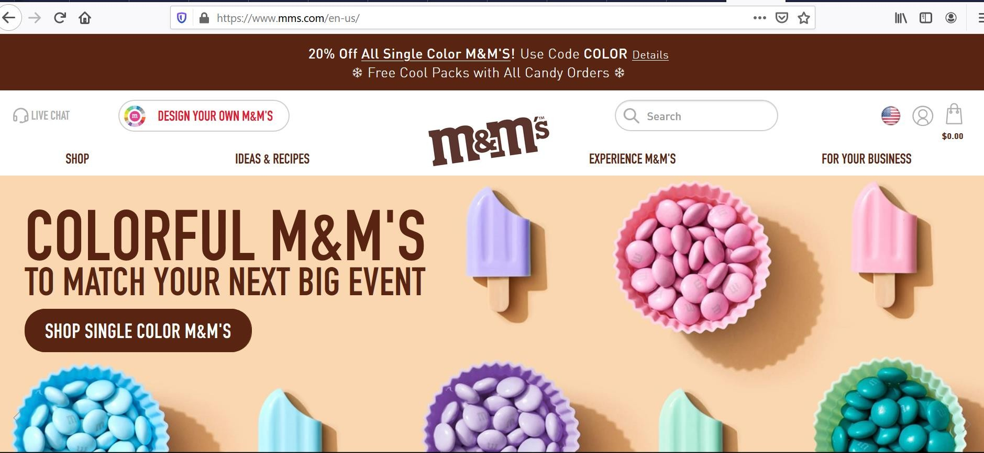
Organizational Responses
Make-to-Order and Mass Customization
-
mass customization.
https://www.mms.com/en-us/

Slide 103
Organizational Responses
E-Business and E-Commerce
E-Business: The business which is done with the help of Internet or Electronic Data Interchange(EDI).
e-Business includes buying & selling of goods, providing services to the customers, communicating with employees, client or business partners can contact the company in case if they want to have a word with the company, or they have any issue regarding the services, etc.
All the basic business operations are done using electronic media.

Slide 104
Organizational Responses
E-Business and E-Commerce
E-Commerce: The process of buying, selling, transferring products or services and or information via computer networks including internet.
It is the subset of e-Business.
Some examples -online banking, online shopping, online ticket booking, social networking, etc.
The basic requirement of e-commerce is a website.

Slide 105
Competitive Advantage and Strategic Information Systems
Introduction
Competitive Advantage refers to any assets that provide an organization with an edge against its competitors in some measure such as cost, quality, or speed.
A competitive strategy is a statement that identifies a business’s approach to compete, its goals, and the plans and policies that will be required to carry out those goals (Porter, 1985).
Advantages :
Outperform its competitors in a critical measure such as cost, quality, and time-to-market.
Function profitably with a market and generate larger-than-average profits.

Slide 106
Competitive Advantage and Strategic Information Systems
Introduction
Strategic Information Systems (SISs) provide a competitive advantage by helping an organization implement its strategic goals and improve its performance and productivity.
Any information system that helps an organization either achieve a competitive advantage or reduce a competitive disadvantage qualifies as a Strategic Information System.

Slide 107
Competitive Advantage and Strategic Information Systems
Porter’s Competitive Forces Model
The best-known framework for analyzing competitiveness.
Companies use Porter’s Model to develop strategies to increase their competitive edge.
Porter’s model identifies five major forces that can endanger or enhance a company’s position in a given industry.
These forces are very valuable as analytical tools is that they have not changed for centuries.

Slide 108
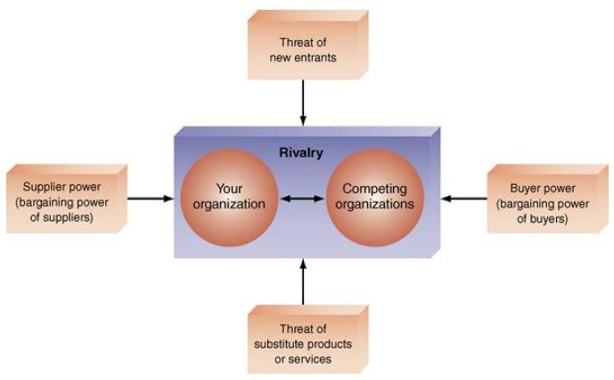
Competitive Advantage and Strategic Information Systems
Porter’s Competitive Forces Model
Figure: Porter’s competitive forces model.

Slide 109
Competitive Advantage and Strategic Information Systems
Porter’s Competitive Forces Model
The threat of entry of new competitors:
The threat that new competitors will enter your market is high when entry is easy and low when there are significant barriers to entry.
An entry barrier is a product or service feature that customers have learned to expect from organizations in a certain industry.
A competing organization must offer this feature in order to survive in the marketplace.
There are many types of entry barriers.
Consider, for example, legal requirements such as admission to the bar to practice law or a license to serve liquor, where only a certain number of licenses are available.

Slide 110
Competitive Advantage and Strategic Information Systems
Porter’s Competitive Forces Model
The threat of entry of new competitors: For most firms, the Web increases the threat that new competitors will enter the market by reducing traditional barriers to entry. Frequently, competitors need only to set up a Web site to enter a market. The Web can also increase barriers to entry, as when customers come to expect a nontrivial capability from their suppliers.
The bargaining power of suppliers: The Web enables buyers to find alternative suppliers and to compare prices more easily, thereby reducing suppliers’ bargaining power. From a different perspective, as companies use the Web to integrate their supply chains, participating suppliers can lock in customers, thereby increasing suppliers’ bargaining power.

Slide 111
Competitive Advantage and Strategic Information Systems
Porter’s Competitive Forces Model
The bargaining power of customers (buyers): The Web provides customers with incredible amounts of choices for products, as well as information about those choices. As a result, the Web increases buyer power. However, companies can implement loyalty programs in which they use the Web to monitor the activities of millions of customers. Such programs reduce buyer power.
The threat of substitute products or services: New technologies create substitute products very rapidly, and the Web makes information about these products available almost instantly. As a result, industries (particularly information-based industries) are in great danger from substitutes (e.g., music, books, newspapers, magazines, soft ware). However, the Web also can enable a company to build in switching costs, so that it will cost customers time and/or money to switch from your company to a competitor.

Slide 112
Competitive Advantage and Strategic Information Systems
Porter’s Competitive Forces Model
The rivalry among existing firms in the industry: In the past, proprietary information systems provided strategic advantage for firms in highly competitive industries. The visibility of Internet applications on the Web makes proprietary systems more difficult to keep secret. Therefore, the Web makes strategic advantage more short-lived.

Slide 113
Competitive Advantage and Strategic Information Systems
Porter’s Value Chain Model
Used to identify specific activities where they can use competitive strategies for greatest impact.
The value chain model identifies points where an organization can use IT to achieve competitive advantage.
Activities divided into two categories: Primary Activities and Support Activities. Primary Activities add value directly to the firm’s products or services. Support Activities contribute to the firm’s competitive advantage by supporting the primary activities.

Slide 114
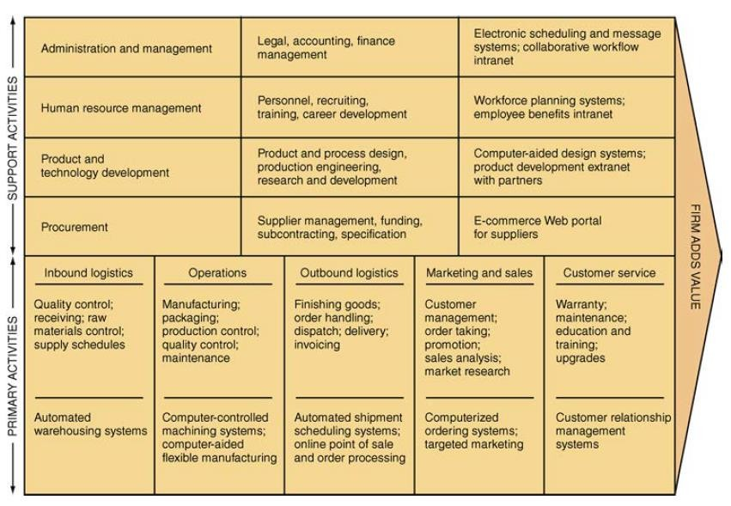
Competitive Advantage and Strategic Information Systems
Porter’s Value Chain Model
http://docshare01.docshare.tips/files/31709/317098453.pdf

Slide 115
Competitive Advantage and Strategic Information Systems
Strategies for Competitive Advantage
Organizations continually try to develop strategies to counter the five competitive forces identified by Porter.
Companies must select a strategy and then stay with it, because a confused strategy cannot succeed.
This selection, in turn, decides how a company will utilize its information systems.

Slide 116
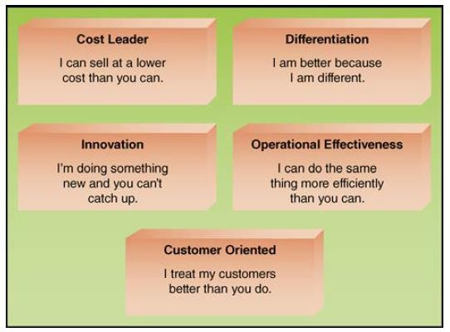
Competitive Advantage and Strategic Information Systems
Strategies for Competitive Advantage
Figure- Strategies for Competitive Advantage

Slide 117
Competitive Advantage and Strategic Information Systems
Strategies for Competitive Advantage
Cost leadership strategy- Produce products and/or services at the lowest cost in the industry. An example is Walmart’s automatic inventory replenishment system, which enables Walmart to reduce inventory storage requirements. As a result, Walmart stores use floor space only to sell products, and not to store them, thereby reducing inventory costs.
Differentiation strategy- Offer different products, services, or product features than your competitors. Southwest Airlines, for example, has differentiated itself as a low-cost, short-haul, express airline. This has proved to be a winning strategy for competing in the highly competitive airline industry.

Slide 118
Competitive Advantage and Strategic Information Systems
Strategies for Competitive Advantage
Innovation strategy- Introduce new products and services, add new features to existing products and services, or develop new ways to produce them. A classic example is the introduction of automated teller machines (ATMs) by Citibank. The convenience and cost-cutting features of this innovation gave Citibank a huge advantage over its competitors. Another excellent example is Apple’s rapid introduction of innovative products.
Operational effectiveness strategy- Improve the manner in which a firm executes its internal business processes so that it performs these activities more effectively than its rivals. Such improvements increase quality, productivity, and employee and customer satisfaction while decreasing time to market.

Slide 119
Competitive Advantage and Strategic Information Systems
Strategies for Competitive Advantage
Customer orientation strategy- Concentrate on making customers happy. Web-based systems are particularly effective in this area because they can create a personalized, one-to-one relationship with each customer.
Amazon (www.amazon.com), Apple (www.apple .com), and Starbucks (www.starbucks.com) are classic examples of companies devoted to customer satisfaction.

Slide 120
Competitive Advantage and Strategic Information Systems
Business–Information Technology Alignment
The best way for organizations to maximize the strategic value of IT
Business– information technology alignment (business-IT alignment) is the tight integration of the IT function with the organization’s strategy, mission, and goals.

Slide 121
Competitive Advantage and Strategic Information Systems
Business–Information Technology Alignment
There are six characteristics of excellent alignment:
Organizations view IT as an engine of innovation that continually transforms the business, often creating new revenue streams.
Organizations view their internal and external customers and their customer service function as supremely important.
Organizations rotate business and IT professionals across departments and
job functions.
Organizations provide overarching goals that are completely clear to each IT and business employee.
Organizations ensure that IT employees understand how the company makes (or loses) money.
Organizations create a vibrant and inclusive company culture.

Slide 122
Competitive Advantage and Strategic Information Systems
Business–Information Technology Alignment
Many organizations fail to achieve this type of close alignment.
The major reasons are the following:
Business managers and IT managers have different objectives.
The business and IT departments are ignorant of the other group’s expertise.
A lack of communication.

Slide 123
Thank You!

